Slide 1
Using Javascript to read data from website.
In this tutorial you will learn how to use Javascript to „read” data to clipboard and use it with Blue Prism.

Slide 2
Requirements
Currently the only way to read data from website is using Internet Explorer with Javascript.
Internet Explorer need to be appropriate configured (set programmaticaly using clipboard – disable as default).
We will use Wikipedia website for this tutorial:
https://en.wikipedia.org/wiki/Robotic_process_automation
On next slide you will see where to change this settings.

Slide 3
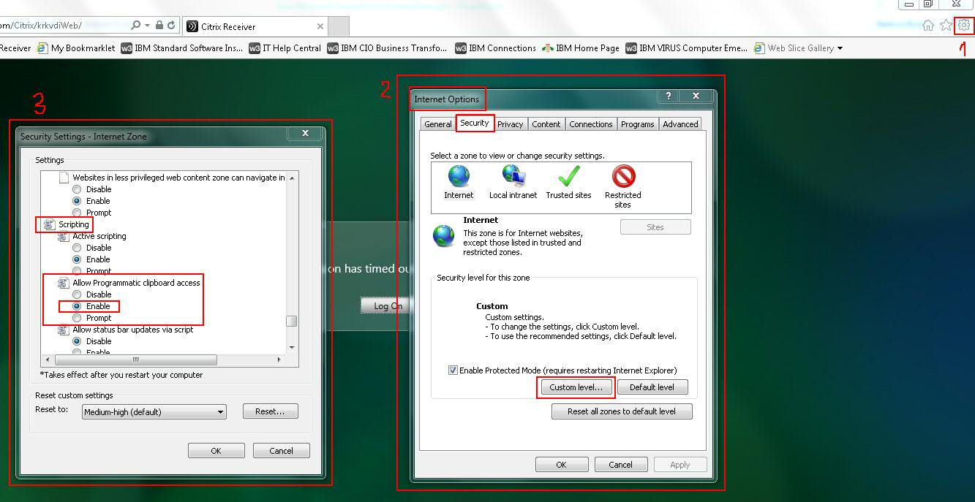

Slide 4
Selecting Text
- If you want „read” something to clipboard first you have to select desired text to copy (like when you do manual text copy).
- There are two different ways of selecting text.
- First way select „readable” text in containers.
- Second way select „input” text contained in input fields or text areas.

Slide 5
Selecting Text in container
If you want to read text from container first you need to find his container ID or make unique selector to reach it (you know how to make selectors from previous workshops).
In this case you can use „mw-content-text” ID (see next slide).
In „mw-content-text” container there is only „readable” text. As „readable” i mean that you cannot change it like in input or text area.

Slide 6
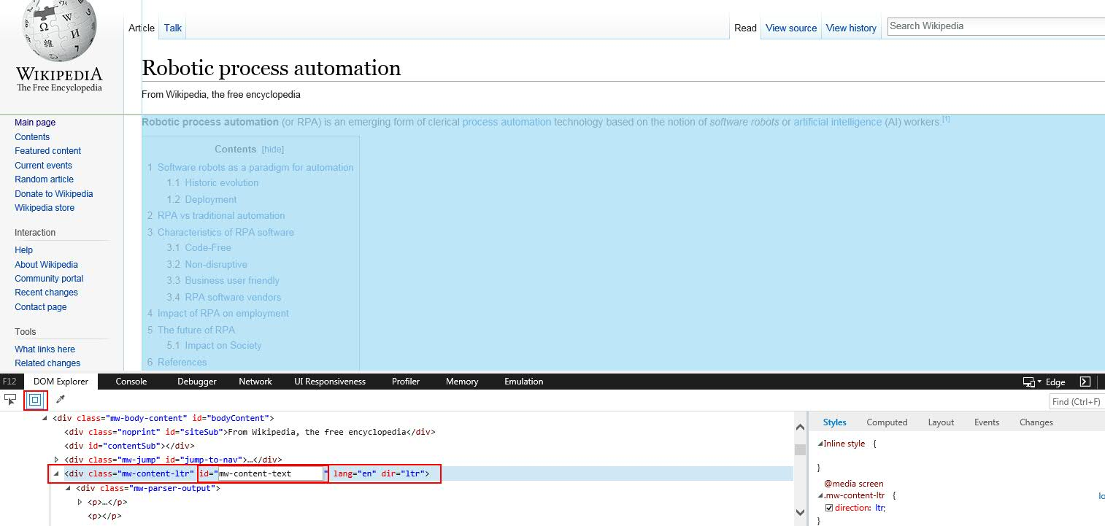

Slide 7
Selecting Text in container
Below function let you create a text range, assign it to your container (by ID) and select it:
//create text range
var range = document.body.createTextRange();
//assign element container to range
range.moveToElementText(document.getElementById("mw-content-text"));
//select range
range.select();

Slide 8
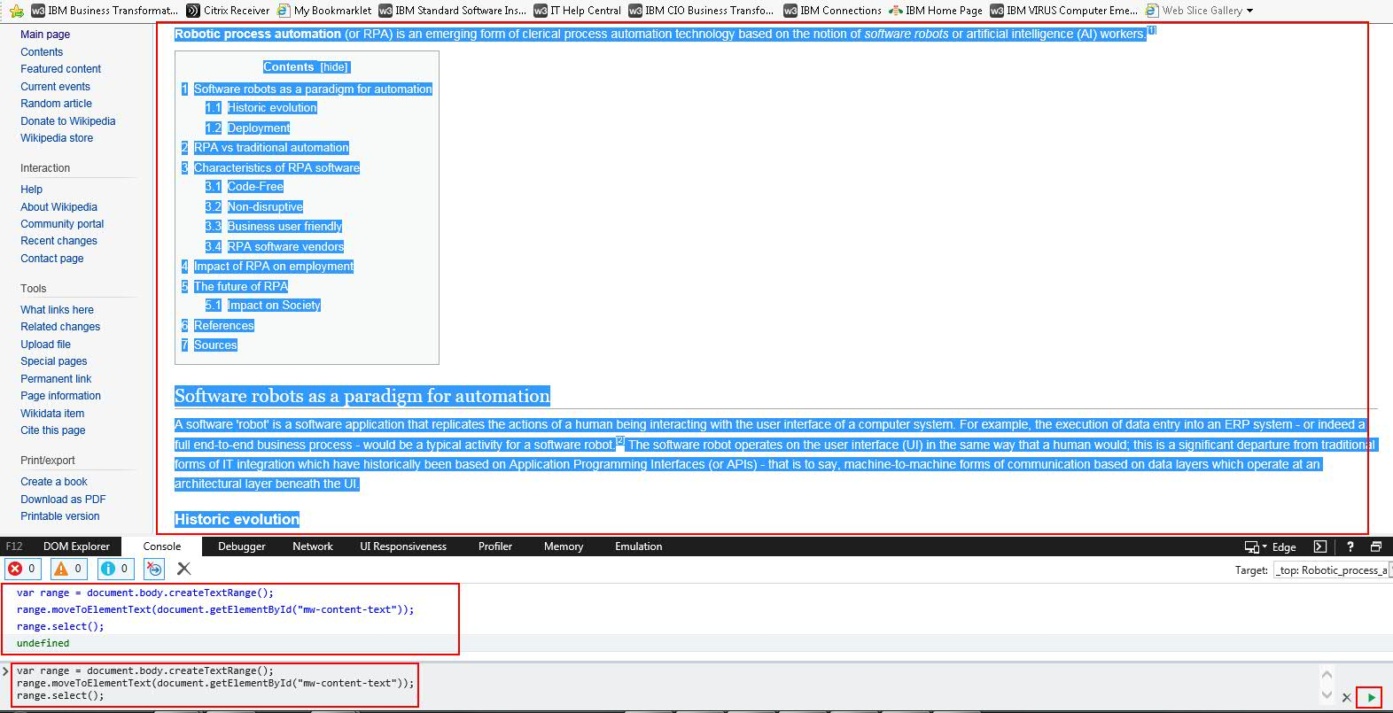

Slide 9
Selecting Text in input
If you want to read text from input first you need to find his ID or make unique selector to reach it (you know how to make selectors from previous workshops).
In this case you can use „searchInput” ID (see next slide).
In „searchInput” input there is only „input” text. As „input” i mean that you can change it.

Slide 10
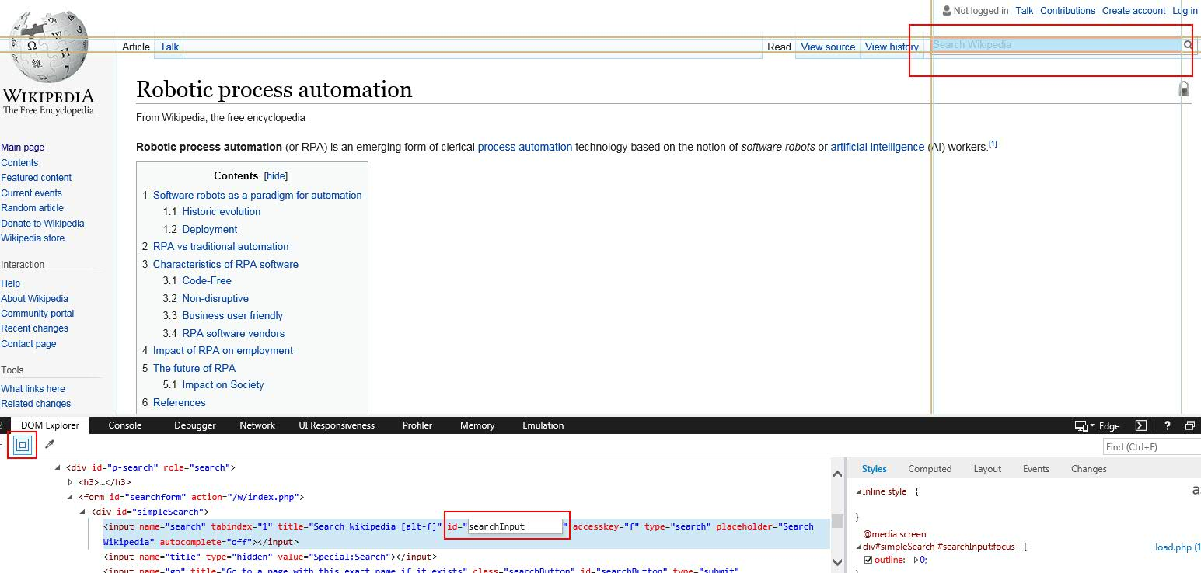

Slide 11
Selecting Text in input
Below function let you select value from input:
//create text range as input
var range = document.getElementById("searchInput");
//select range
range.select();

Slide 12
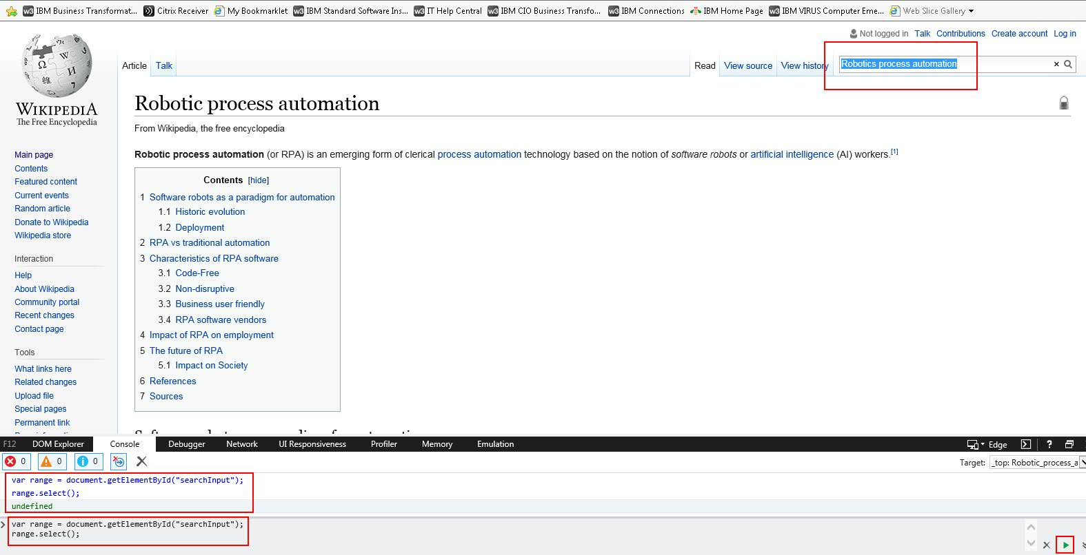

Slide 13
Copy to clipboard
After you select desired text now only thing you need to do is copy this text. But it is not so easy as manual copy.
Javascript provides „document.execCommand('copy');” function which works just as Ctrl + C shortcut. But to use it in code there is one important step to take.
Javascript needs user to „do event” for triggering this command. So you need to create artificial event and trigger it.
See next slides

Slide 14
Event listener
You need event listener to „listen” for particular „event” will occur.
//.addEventListener function need a „event” and function which will be released after event occur. In this case it is „blur” event.
document.addEventListener('blur', function () {
//here should be you text select code
document.execCommand('copy');
});

Slide 15
Triggering event
You need a mechanism to trigger event that event listener is listen for.
//create artificial event
var event = document.createEvent('Event');
//set event details (for more options see javascript documentation)
event.initEvent('blur', true, true);
//trigger artificial event
document.dispatchEvent(event);

Slide 16
Code worked
If your code worked you should have result in your clipboard.
Now only thing to do is use Blue Prism Get Clipboard action to retrieve data from webiste

Slide 17
Example select and copy function (text in container) working on Internet Explorer 9+ (wiki RPA website)
document.addEventListener('blur', function () {
var range = document.body.createTextRange();
range.moveToElementText(document.getElementById("mw-content-text"));
range.select();
document.execCommand('copy');
});
var event = document.createEvent('Event');
event.initEvent('blur', true, true);
document.dispatchEvent(event);

Slide 18
Example select and copy function (text in input) working on Internet Explorer 9+ (wiki RPA website)
document.addEventListener('blur', function () {
var range = document.getElementById("searchInput");
range.select();
document.execCommand('copy');
});
var event = document.createEvent('Event');
event.initEvent('blur', true, true);
document.dispatchEvent(event);

Slide 19
Example select and copy function (text in container) working on Internet Explorer 8- (wiki RPA website)
document.attachEvent("onclick", function(){
var range = document.body.createTextRange();
range.moveToElementText(document.getElementById("mw-content-text"));
range.select();
document.execCommand("copy");
});
var event = document.createEventObject();
event.eventType = "click";
event.eventName = "click";
document.fireEvent("on" + event.eventType, event);

Slide 20
Example select and copy function (text in input) working on Internet Explorer 8- (wiki RPA website)
document.attachEvent("onclick", function(){
var range = document.getElementById("searchInput");
range.select();
document.execCommand("copy");
});
var event = document.createEventObject();
event.eventType = "click";
event.eventName = "click";
document.fireEvent("on" + event.eventType, event);

Slide 21
Advice with artificial events
Be aware that page you want to make artificial event can have its own event listeners which listen for event you want to use...
Be aware that if you create event listener for particular event and then use Blue Prism to do some action that listener is listen for this action will trigger your event (for example you create event listeing for „click”)
Be aware that this is only workaround and unofficial way to handle reading using Javascript but it works ☺
Have fun!

